Slide 1
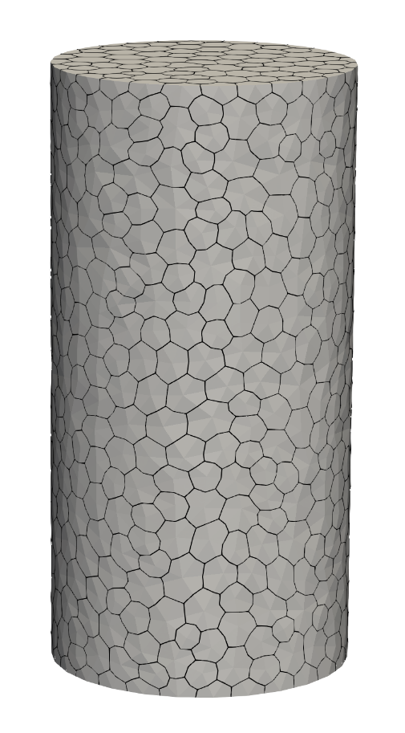
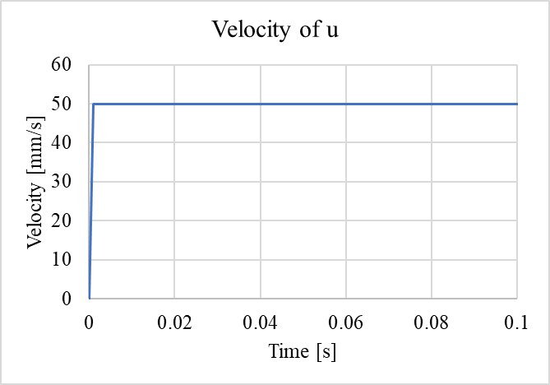
Uniaxial test
Size in XYZ: 100mm x 100mm x 200mm
RP1 (-0.216909751, -0.156103104, 200):
(Central nodes at top, may not be exactly at 0)
dx = 0; dy = 0; dz = u;
rx = 0; ry = 0; rz = 0
RP2 (-0.216909751, -0.156103104, 0):
(Central nodes at bottom , may not be exactly at 0)
dx = 0; dy = 0; dz = 0;
rx = 0; ry = 0; rz = 0
Tie:
RP1 -> nodes on the top (z=200)
RP2 -> nodes on the bottom (z=0)
dz; rx; ry are the same
Surrounding nodes:
(nodes on the surface of cylinder)
dx = 0; dy = 0
RP1
0.001
Z
Y
X
RP2

Slide 2
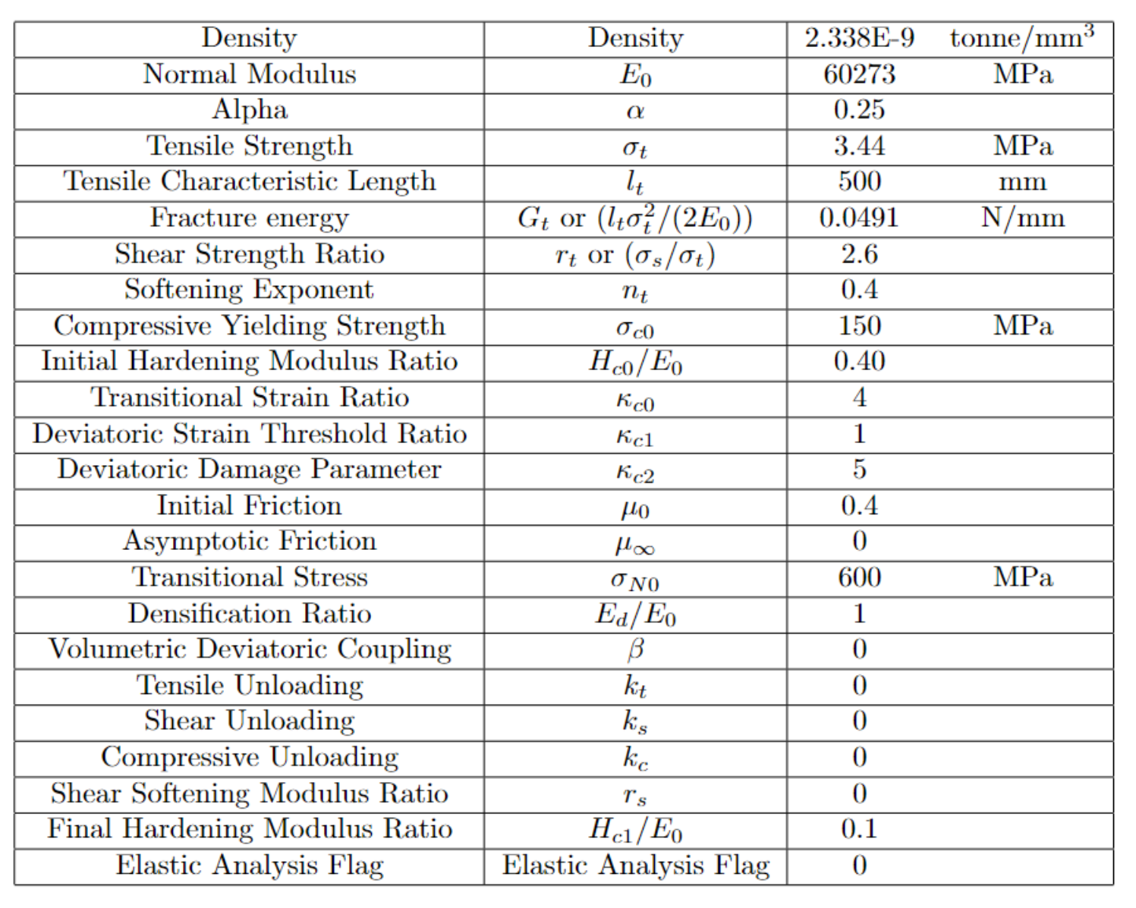
Material Property
Same as TPB test

Slide 3
